Slide 1


REARRANGEMENTS
SEMESTER – IV
CBCS SYSTEM
PRESENTED
BY
DR.MUMU CHAKRABORTY
ASSISTANT PROFESSOR
DEPARTMENT OF CHEMISTRY
GOVERNMENT GIRLS’ GENERAL DEGREE COLLEGE
7, MAYUR BHANJ ROAD
KOLKATA – 700023, WEST BENGAL, INDIA

Slide 2

Diazonium salts and their related compounds: reactions (with mechanism) involving
replacement of diazo group; reactions: Gomberg, Meerwein, Japp-Klingermann.
Rearrangements(14 Lectures)
Mechanism with evidence and stereochemical features for the following:
Rearrangement to electron-deficient carbon: Wagner-Meerwein rearrangement, pinacol
rearrangement, dienone-phenol; Wolff rearrangement in Arndt-Eistert synthesis, benzil benzilic acid rearrangement, Demjanov rearrangement, Tiffeneau–Demjanov
rearrangement.
Rearrangement to electron-deficient nitrogen: rearrangements: Hofmann, Curtius,
Lossen, Schmidt and Beckmann.
Rearrangement to electron-deficient oxygen: Baeyer-Villiger oxidation, cumene
hydroperoxide-phenol rearrangement and Dakin reaction.
Aromatic rearrangements:Migration from oxygen to ring carbon: Fries rearrangement
and Claisen rearrangement.
Migration from nitrogen to ring carbon: Hofmann-Martius rearrangement, Sommelet
Hauser rearrangement, Fischer-Hepp rearrangement, N-azo to C-azo rearrangement,
Bamberger rearrangement, Orton rearrangement and benzidine rearrangement.

Slide 3
Rearrangement to electron-deficient carbon:
1. Demjanov rearrangement
2. Tiffeneau–Demjanov rearrangement

Slide 4
Demjanov Rearrangement (Rearrangement to electron-deficient carbon):

Slide 5


Slide 6

Tiffanaeu – Demjanov (Rearrangement to electron-deficient carbon) :

Slide 7
Diazonium salts and their related compounds: reactions (with mechanism) involving
replacement of diazo group; reactions:
Gomberg, Meerwein, Japp-Klingermann.

Slide 8
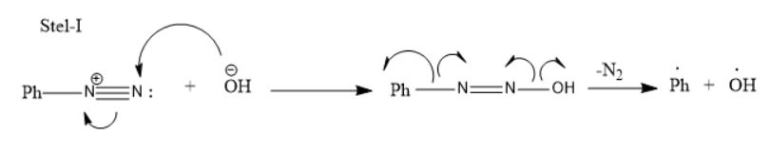
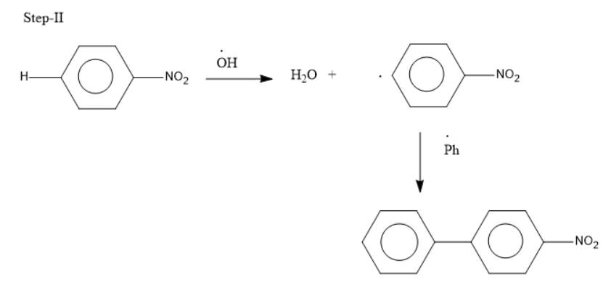

Gomberg Reaction:

Slide 9
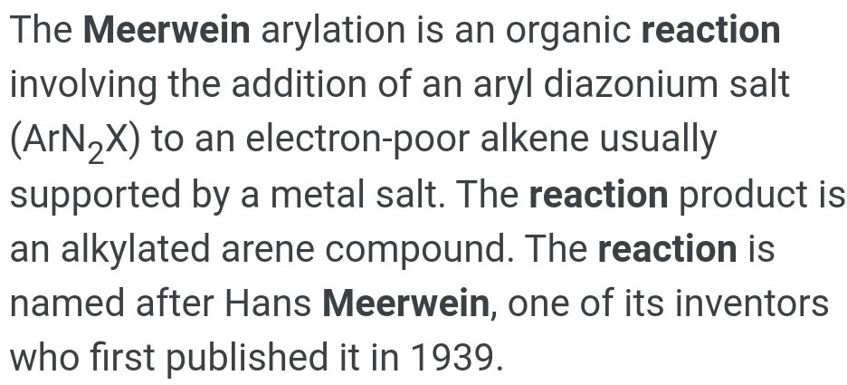
Meerwein Reaction

Slide 10
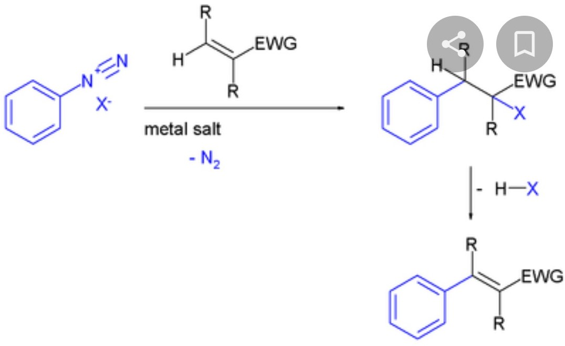
Meerwein Reaction

Slide 11
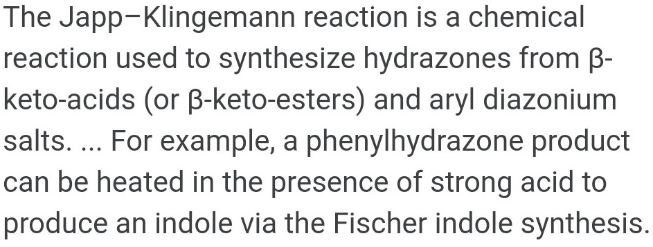
Japp-Klingemann Reaction:

Slide 12
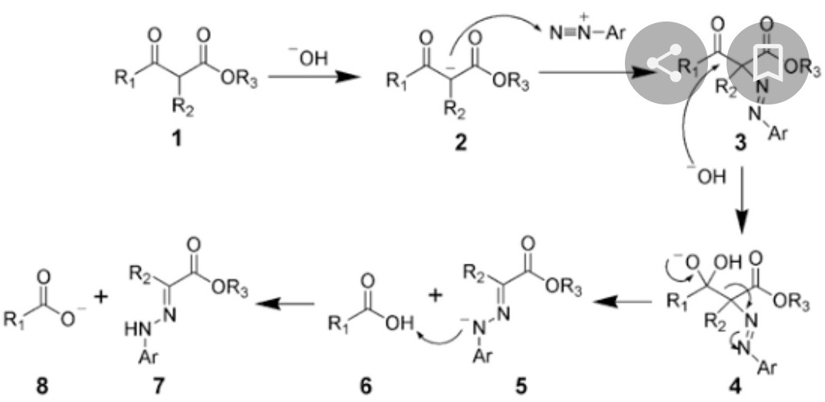
Japp-Klingemann Reaction:

Slide 13
Migration from nitrogen to ring carbon:
Hofmann-Martius rearrangement

Slide 14
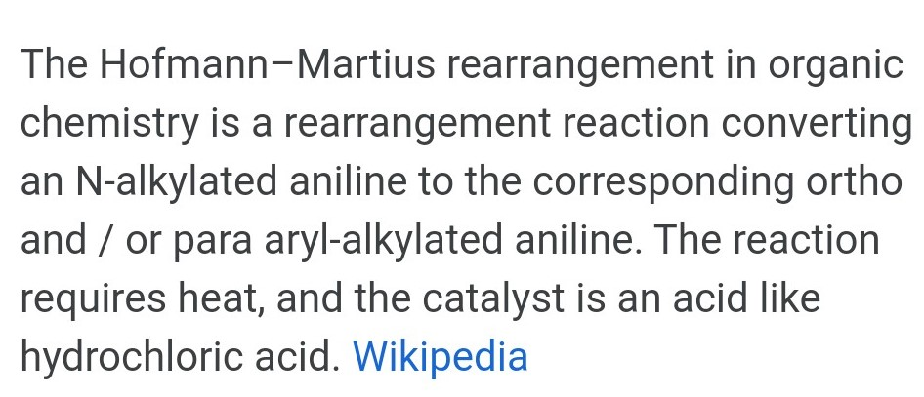
Hofmann-Martius Rearrangement:

Slide 15
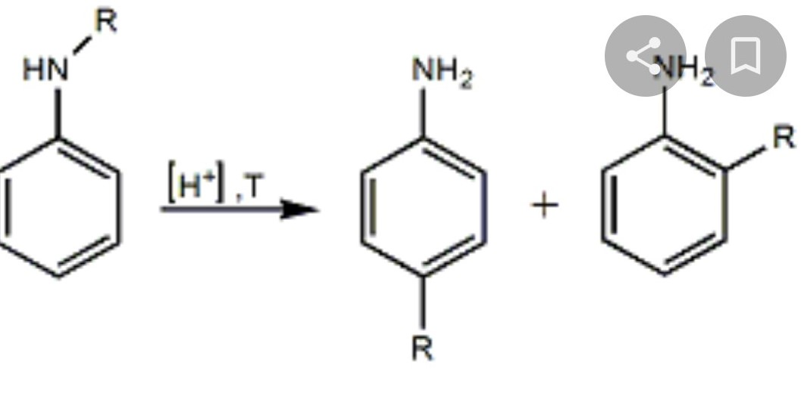
Hofmann-Martius Rearrangement:

Slide 16
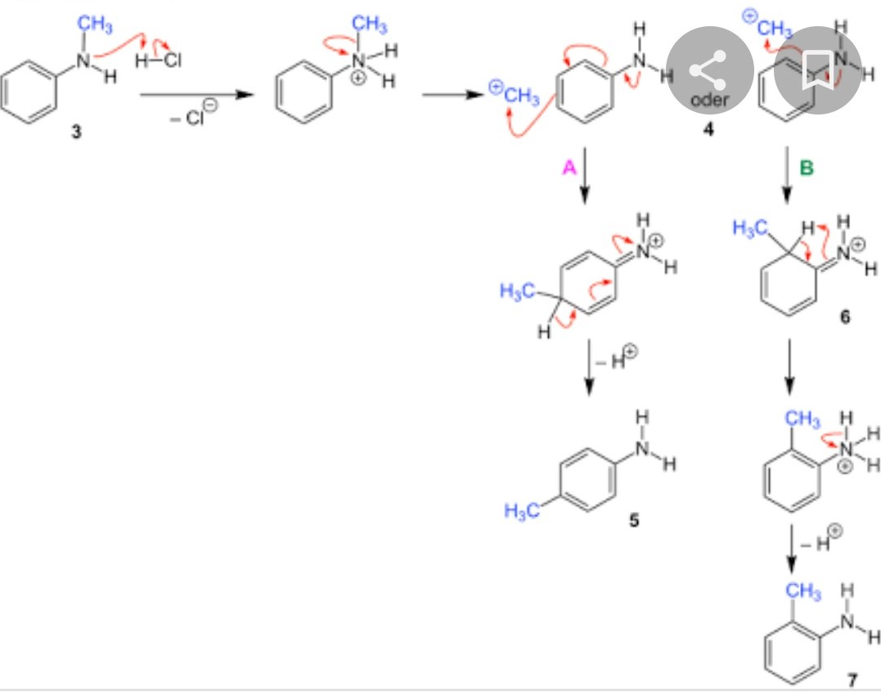
Mechanism of Hofmann-Martius Rearrangement

Slide 17
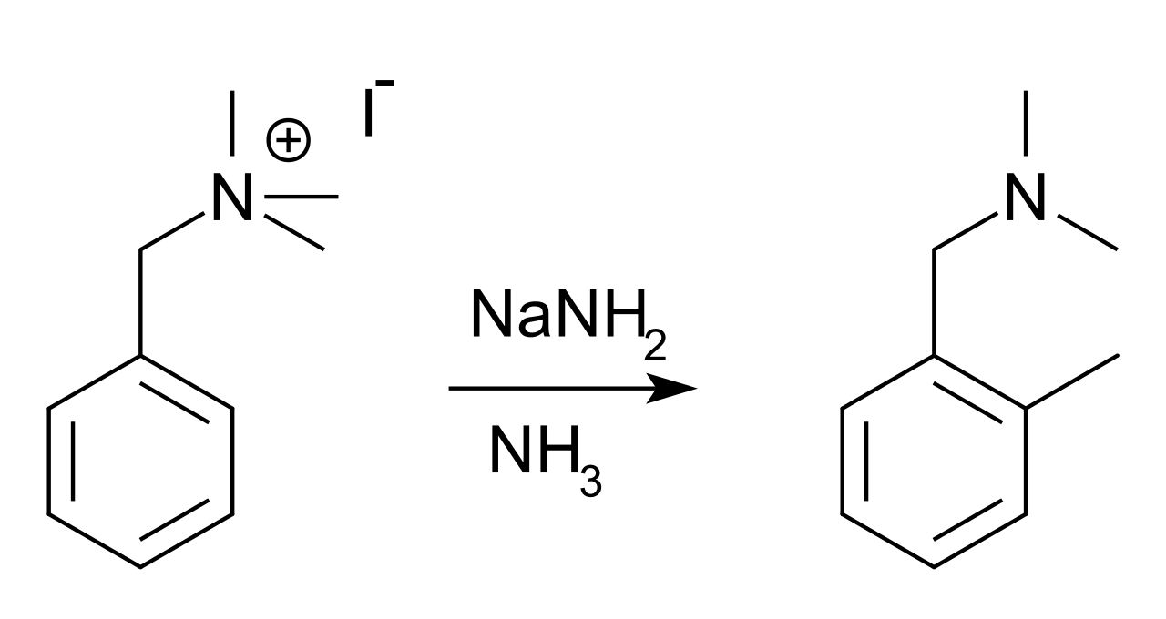
Sommelet-Hauser Rearrangement:
The Sommelet–Hauser rearrangement (named after M. Sommelet and Charles R. Hauser) is a rearrangement reaction of certain benzyl quaternary ammonium salts. The reagent is sodium amide or another alkali metal amide and the reaction product a N,N-dialkylbenzylamine with a new alkyl group in the aromatic ortho position. For example, benzyltrimethylammonium iodide, [(C₆H₅CH₂)N(CH₃)₃]I, rearranges in the presence of sodium amide to yield the o-methyl derivative of N,N-dimethylbenzylamine.

Slide 18
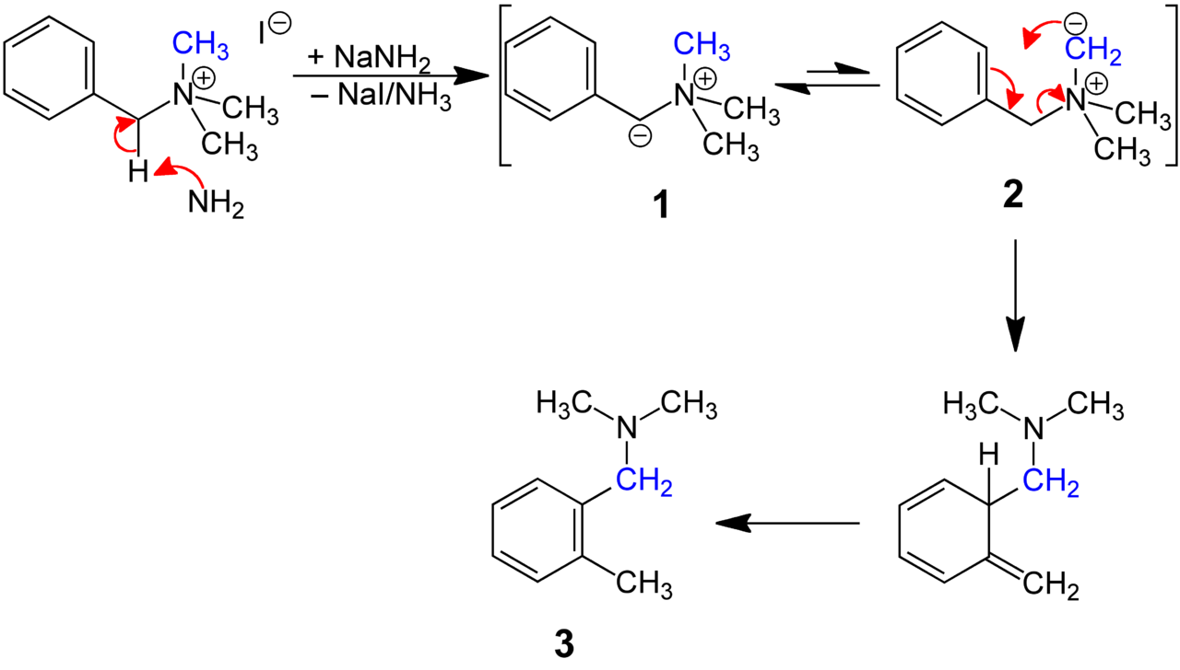
Mechanism:
The benzylic methylene proton is acidic and deprotonation takes place to produce the benzylic ylide (1). This ylide is in equilibrium with a second ylide that is formed by deprotonation of one of the ammonium methyl groups (2). Though the second ylide is present in much smaller amounts, it undergoes a 2,3-sigmatropic rearrangement and subsequent aromatization to form the final product (3).

Slide 19

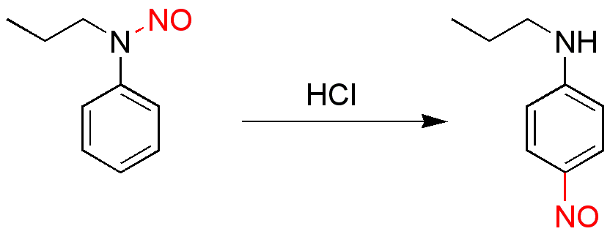
Fischer-Hepp Rearrangement
The Fischer–Hepp rearrangement is a rearrangement reaction in which an aromatic N-nitroso or nitrosamine converts to a carbon nitroso compound.
This organic reaction was first described by the German chemist Otto Philipp Fischer (1852–1932 ) and Eduard Hepp (June 11, 1851 – June 18, 1917) in 1886, and is of importance because para-NO secondary anilines cannot be prepared in a direct reaction.
The rearrangement reaction takes place by reacting the nitrosamine precursor with hydrochloric acid. The chemical yield is generally good under these conditions, but often much poorer if a different acid is used. The exact reaction mechanism is unknown but there is evidence suggesting an intramolecular reaction.

Slide 20
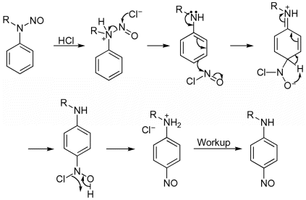
Mechanism of Fisher-Hepp Reaction:

Slide 21
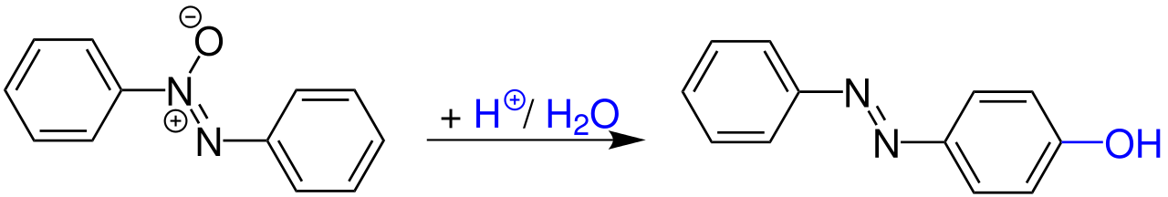
N-azo to C-azo Rearrangement
The Wallach rearrangement is an organic reaction converting an aromatic azoxy compound with sulfuric acid or other strong acids to an azo compound with one arene ring substituted by a hydroxyl group in the aromatic para position.

Slide 22
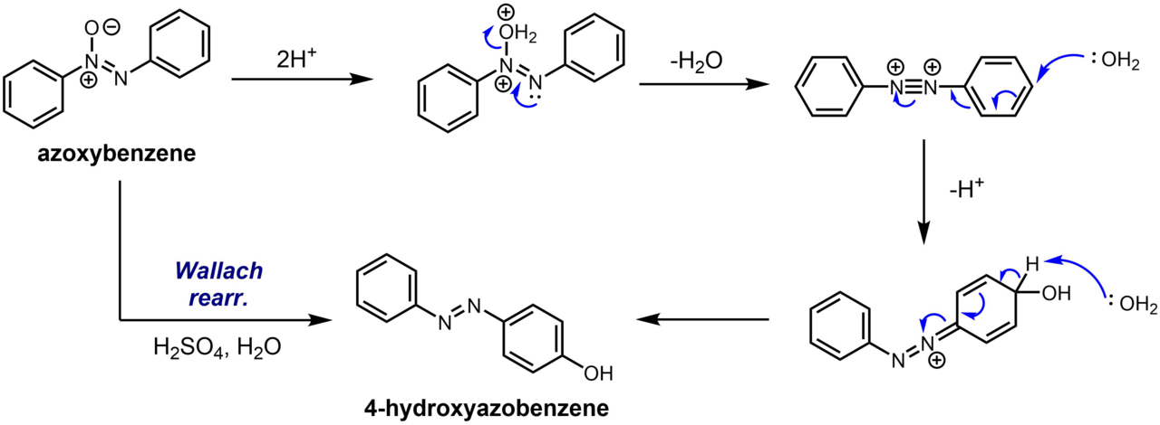
Mechanism:

Slide 23
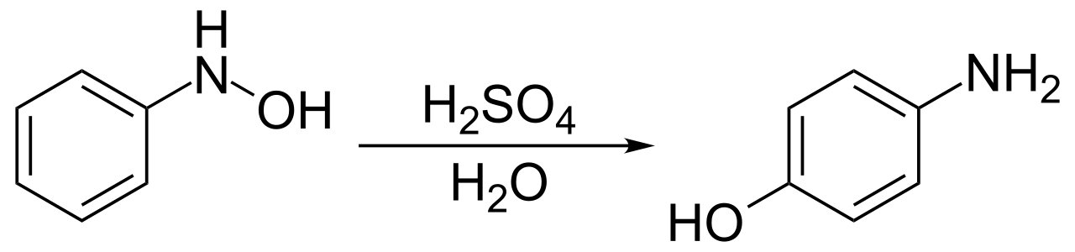
Bamberger Rearrangement:
The Bamberger rearrangement is the chemical reaction of phenylhydroxylamines with strong aqueous acid, which will rearrange to give 4-aminophenols. It is named for the German chemist Eugen Bamberger (1857–1932).
Mechanism:
The mechanism of the Bamberger rearrangement proceeds from the monoprotonation of N-phenylhydroxylamine 1. N-protonation 2 is favored, but unproductive. O-protonation 3 can form the nitrenium ion 4, which can react with nucleophiles (H₂O) to form the desired 4-aminophenol 5.

Slide 24
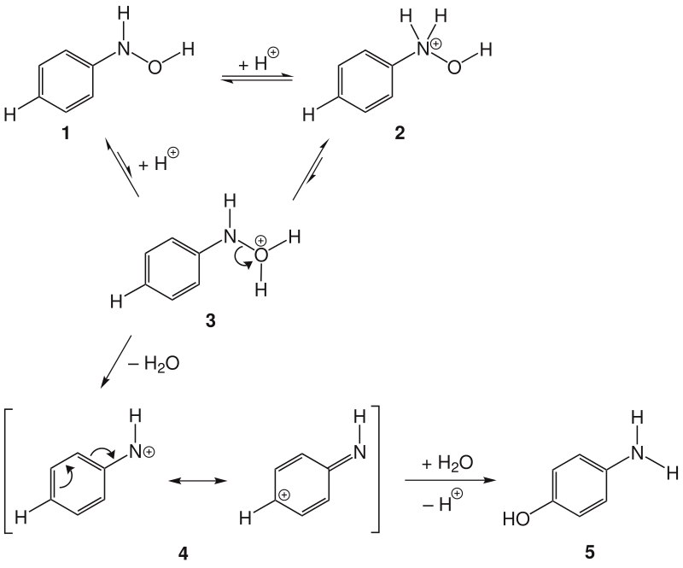

Slide 25
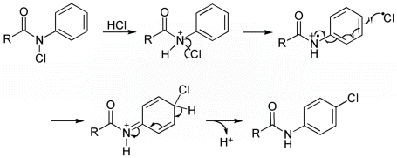
Orton rearrangement
This reaction is the rearrangement of an N ‐chloro acyl anilide into an N ‐acyl p ‐chloroanilide in the presence of an acid such as HCl and is generally known as the Orton rearrangement. This reaction proceed via a multistep processes and is promoted simultaneously by proton (i.e., H⁺) and chloride. It has been found that both solvent composition and substrate influence this rearrangement. In addition, the Orton rearrangement can be triggered by a Lewis acid as well as by light. Furthermore, it has been reported that the chlorination of acyl anilide from chlorine can proceed by two paths and the ortho/para ratio of isomers increase when the solvent viscosity is increased. This reaction is useful for the preparation of para ‐halo anilides.

